Slide 1
Satellite/Aerial Image Retrieval
Venkata Akshith Reddy Kasireddy (A20455209)
Sai Vishal Kodimela (A20453006)
Nikhil Sarika (A20470289)
Souporno Ghosh (A20439047)

Slide 2
Content
Introduction
Our Method
Result
Future Improvements
References

Slide 3
Introduction

Slide 4
Our Goal :
Given two points in geo coordinate, return the map image bounded by the two points with acceptably finest resolution.
Use Bing Map Tile System to obtain the required highest resolution Aerial Image.
Input and Output :
Input: 2 bounding coordinates
lat1, lon1, lat2, lon2
Output:
an aerial imagery within the bounding box defined above.

Slide 5
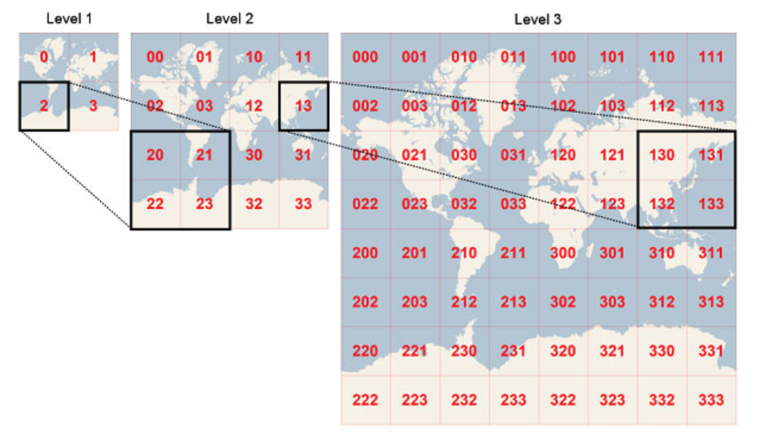
Bing Maps Tile System
Project the world map to a square number of pixels. A bunch of pixels consist a tile orderly.
In higher level, there are more pixels, bigger map size, more tiles, and finer ground resolution. There are 23 levels in total. Each tile in current level expand to 4 tiles in next finer level.

Slide 6
Bing Maps Tile System (Con.)
Tile System
Quadkey
Each Level: L
Each Tile:
23-L levels
Each Tile
23 Levels
Tile Coordinates
Pixel Coordinates

Slide 7
Our Method

Slide 8
Tools We used
Python 3.6
Package: Pillow
Bing Map Tile System

Slide 9
Query a Aerial Image from Bing Map Tile System
Query from URL by quadkey:
http://ho.ortho.tiles.virtualearth.net/tiles/hquadkey.jpeg?g=131
quadkey: can be generated by converting a pair of latitude and longitude.
Extract the socket and obtain the queried tile image.

Slide 10
Generate Bounding Box of Aerial Image
Find the smallest tile which bounds everything of our bounding box.
Inside this base tile, recursively find finest tiles.
Base Tile
From level 23 to lower levels, find the first non-null tile aerial images.
Stitch these tiles together to generate a “finest tile”
Finest Tile
Convert Longitudes and latitudes to pixel coordinates in the finest tile.
Crop the finest tile to the bounding box of required aerial image.
Cropping

Slide 11
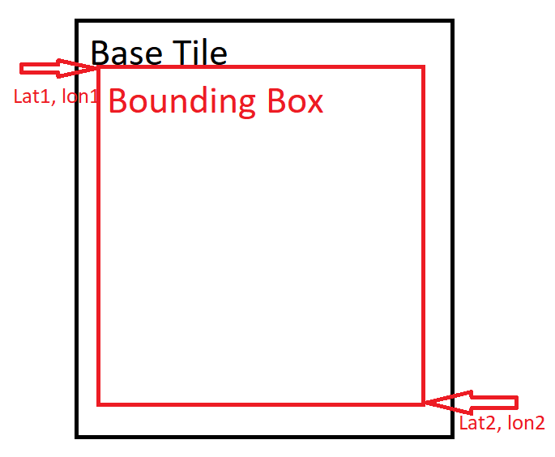
Base Tile
•Input latitudes, longitudes: lat1, lon1, lat2, lon2
•Convert inputs to tile coordinates: x1, y1, x2, y2
•Search From level 23 to level 1
•If |x1-x2|≤1 and |y1-y2|≤1
•This tile level is the base tile level
•Return the tile level and tile coordinate x1, y1

Slide 12
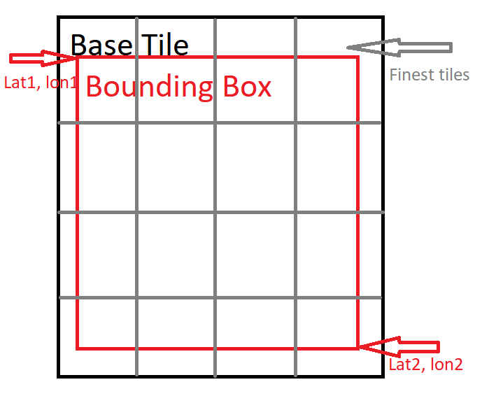
Finest Tile
Input tile coordinates: x1, y1, x2, y2 and tile level.
From level 23 to base tile level:
If we can query all tile images in this level,
Return all tile images inside base tile.
Stitch these tile images together to generate finest tile image.
Return finest tile image.

Slide 13
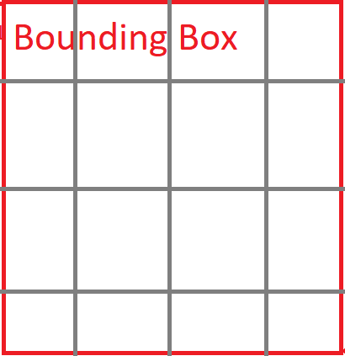
Cropping
Input: lat1, lon1, lat2, lon2 and finest tile image.
Convert latitudes and longitudes into pixel coordinates of finest tile.
Cropping finest tile image by the pixel coordinates to generate required bounding box of aerial image.
Return the bounding box image.

Slide 14
Results

Slide 15
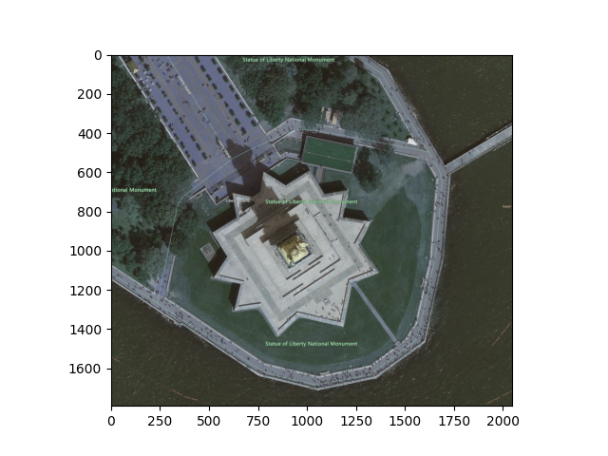
Aerial Image of Statue of Liberty
Bounding Box:
Top Left Corner:
Latitude: 41.839341
Longitude: -87.629504
Bottom Right Corner:
Latitude: 41.831092
Longitude: -87.623239

Slide 16
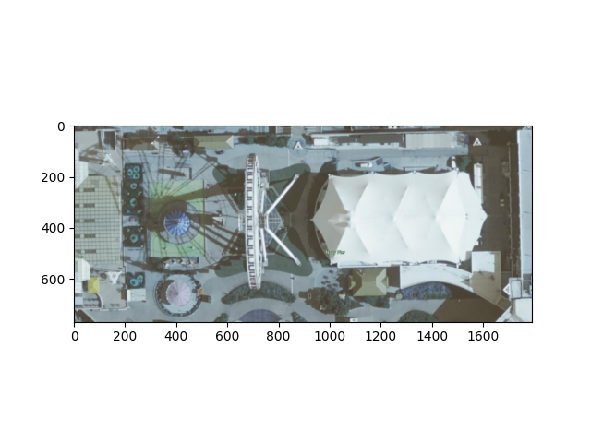
Aerial Image of Chicago Navy Pier
Bounding Box:
Top Left Corner:
Latitude: 41.888438
Longitude: -87.644858
Bottom Right Corner:
Latitude: 41.848298
Longitude: -87.614988

Slide 17
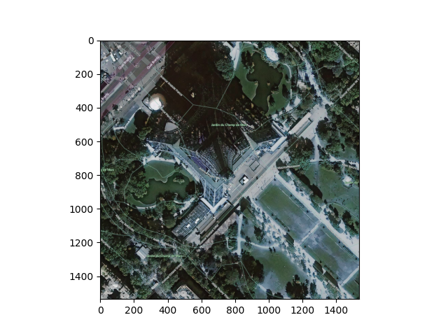
Aerial image of Eiffel Tower

Slide 18
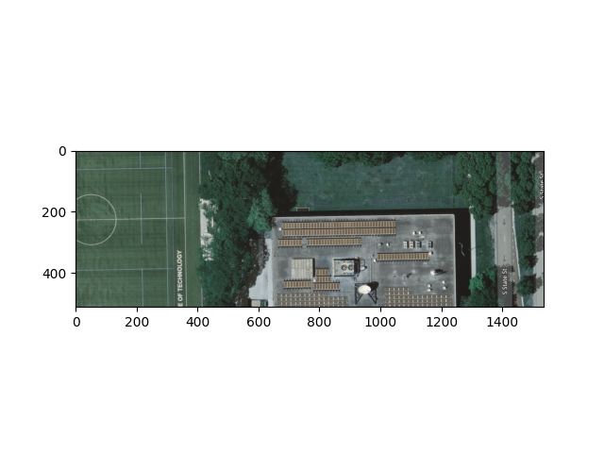
Aerial image of Stuart Building

Slide 19
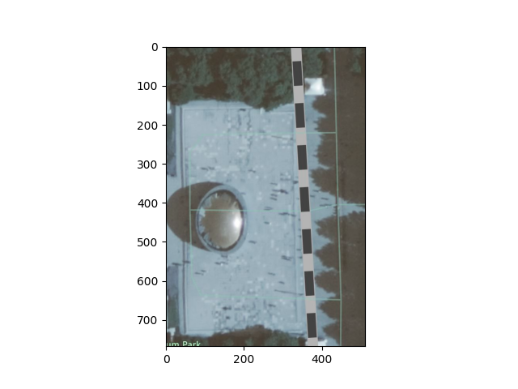
Aerial image of Chicago Bean

Slide 20
Future Improvements
Python’s PIL has a memory allocation limit
Too many tiles == doesn’t work
Our limit: 2¹³x2¹³ or 8192x8192 pixels
Threaded Performance:
Good for High Level of detail
Requires lots of memory

Slide 21
References
Bing Maps Tile System : “https://docs.microsoft.com/en-us/bingmaps/articles/bing-maps-tile-system”

Slide 22
Thanks！

